Slide 1

Web Engineering
HTML Forms

Slide 2
The <form> Element
The <form> element is a container for different types of input elements, such as: text fields, checkboxes, radio buttons, submit buttons, etc.
<form> . form elements . </form>

Slide 3
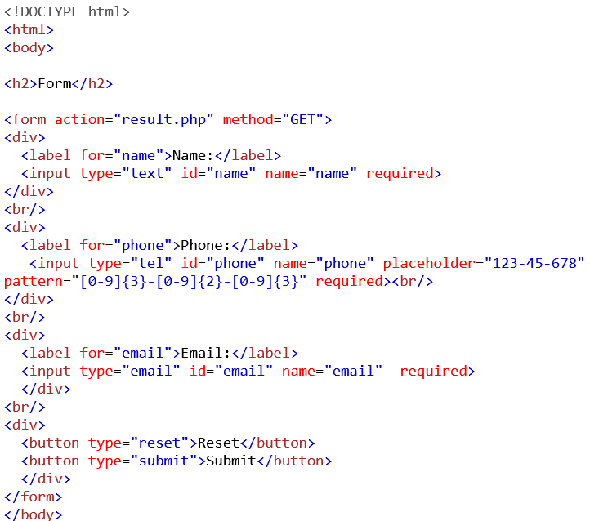
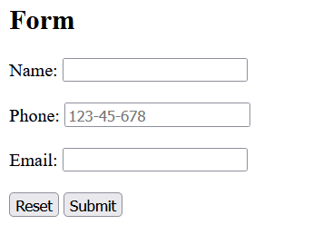
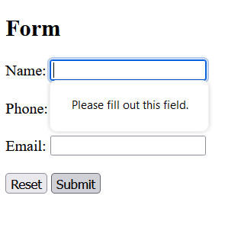
Example: Name, Phone, Email

Slide 4
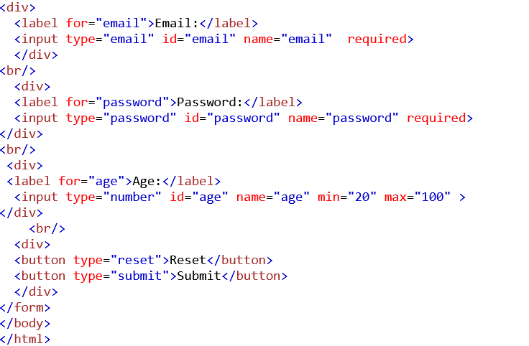
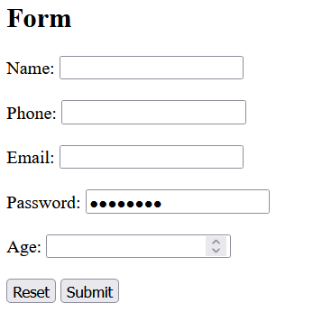
Password, Number

Slide 5
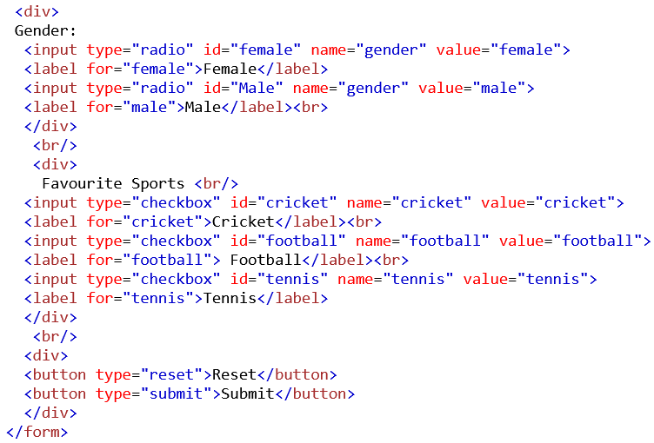
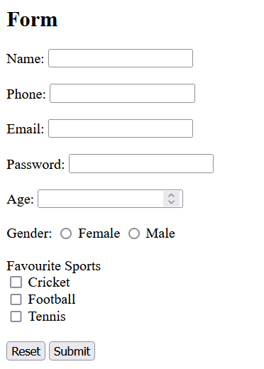
Radio and Checkbox

Slide 6
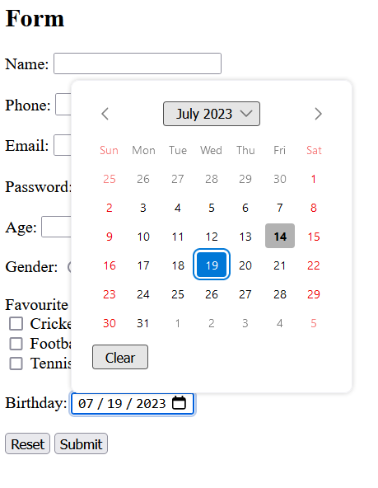
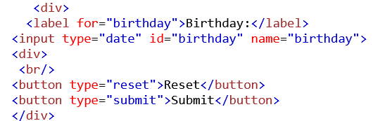
Date

Slide 7
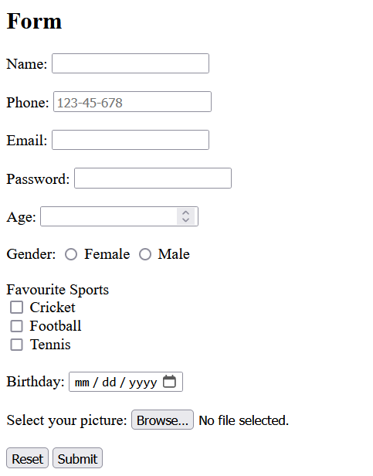
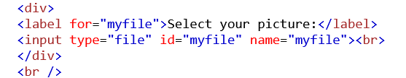
File

Slide 8
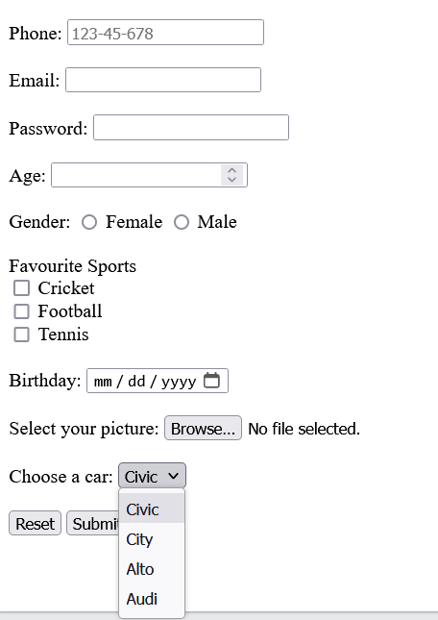
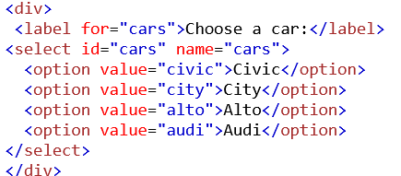
Select

Slide 9
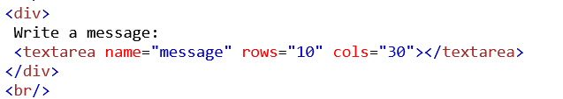
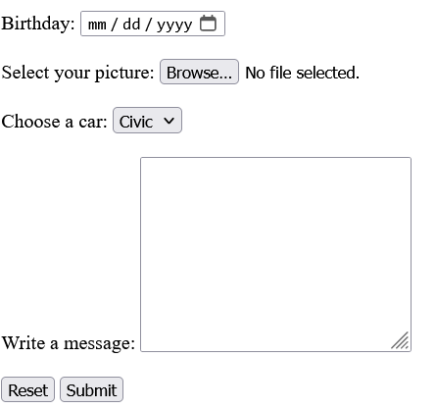
Text area

Slide 10
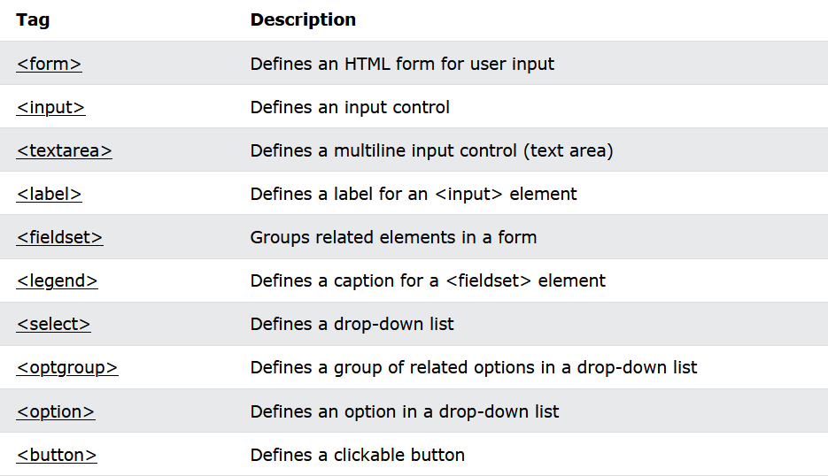
HTML Form Elements

Slide 11
Code
<!DOCTYPE html>
<html>
<body>
<h2>Form</h2>
<form action="result.php" method="GET">
<div>
<label for="name">Name:</label>
<input type="text" id="name" name="name" required>
</div>
<br/>
<div>
<label for="phone">Phone:</label>
<input type="tel" id="phone" name="phone" placeholder="123-45-678" pattern="[0-9]{3}-[0-9]{2}-[0-9]{3}" required><br/>
</div>
<br/>
<div>
<label for="email">Email:</label>
<input type="email" id="email" name="email" required>
</div>

Slide 12
Code
<br/>
< <br/>
<div>
Favourite Sports <br/>
<input type="checkbox" id="cricket" name="cricket" value="cricket">
<label for="cricket">Cricket</label><br>
<input type="checkbox" id="football" name="football" value="football">
<label for="football"> Football</label><br>
<input type="checkbox" id="tennis" name="tennis" value="tennis">
<label for="tennis">Tennis</label>
</div>
<br/>
<div>
<br/>
<div>
<label for="password">Password:</label>
<input type="password" id="password" name="password" required>
</div>
<br/>
<div>
<label for="age">Age:</label>
<input type="number" id="age" name="age" min="20" max="100" >
</div>
<br/>
<div>
Gender:
<input type="radio" id="female" name="gender" value="female">
<label for="female">Female</label>
<input type="radio" id="Male" name="gender" value="male">
<label for="male">Male</label><br>
</div>

Slide 13
Code
<label for="birthday">Birthday:</label>
<input type="date" id="birthday" name="birthday">
</div>
<br/>
<div>
<label for="myfile">Select your picture:</label>
<input type="file" id="myfile" name="myfile"><br>
</div>
<br />
<div>
<label for="cars">Choose a car:</label>
<select id="cars" name="cars">
<option value="civic">Civic</option>
<option value="city">City</option>
<option value="alto">Alto</option>
<option value="audi">Audi</option>
</select>
</div>
<br/>
<div>
Write a message:
<textarea name="message" rows="10" cols="30"></textarea>
</div>
<br/>
<div>
<button type="reset">Reset</button>
<button type="submit">Submit</button>
</div>
<br/> <br/> <br/>
</form>
</body>
</html>

Slide 14
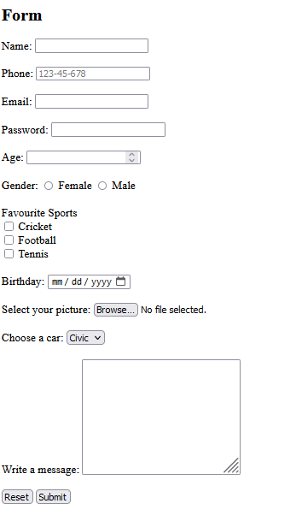
Form

Slide 15
HTML 5
New available types of form controls include dates and times, email, url, search, number, range, tel and color.

Slide 16
References
https://www.w3schools.com/html/html_forms.asp
https://www.youtube.com/watch?v=fNcJuPIZ2WE

Slide 17


